Slide 1
Are data breached an inevitability?
How do we minimise the risks?
IS DATA BREACH INEVITABLE?

Slide 2
Recent Data Breaches
User records compromised
Name of the Organization Year Records Compromised (approx.)
Quora 2018 100 million
My Fitness Pal 2018 144 million
Dubsmash 2018 161 million
Equifax 2017 148 million
Friend Finder Networks 2016 412 million
Yahoo! 2014 500 million
Marriott International 2014 383 million
Target 2013 110 million
Yahoo! 2013 3.0 billion
https://blog.eccu.edu/data-breaches-are-inevitable-are-you-prepared/

Slide 3
Types of Data Breach
GDPR
Confidentiality breach – where there is an unauthorised or accidental disclosure of, or access to, personal data.
Integrity breach – where there is an unauthorised or accidental alteration of personal data.
Availability breach – where there is an accidental or unauthorised loss of access to, or destruction of, personal data.
https://dataconversion.ie/gdpr-databreaches/

Slide 4
Cost of Data Breach
GDPR Penalties and Fines
Maximum fine
£17.8 million or 4% of annual global turnover (whichever is greater)
Other actions include
Issuing warnings and reprimands
Imposing a temporary or permanent ban on data processing
Ordering the rectification, restriction or erasure of data
Suspending of data transfer to third countries
https://www.itgovernance.co.uk/dpa-and-gdpr-penalties

Slide 5
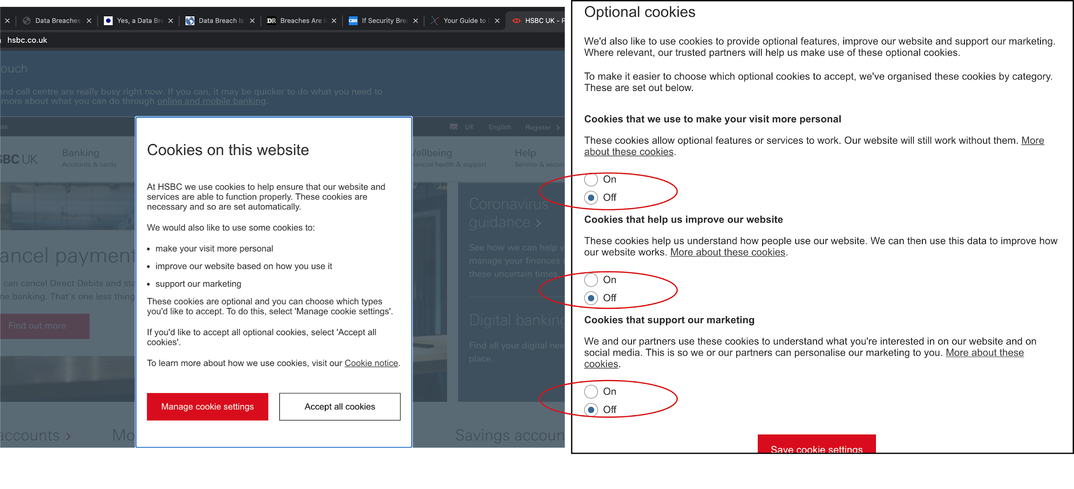
Data Protection Online
GDPR in the UK

Slide 6
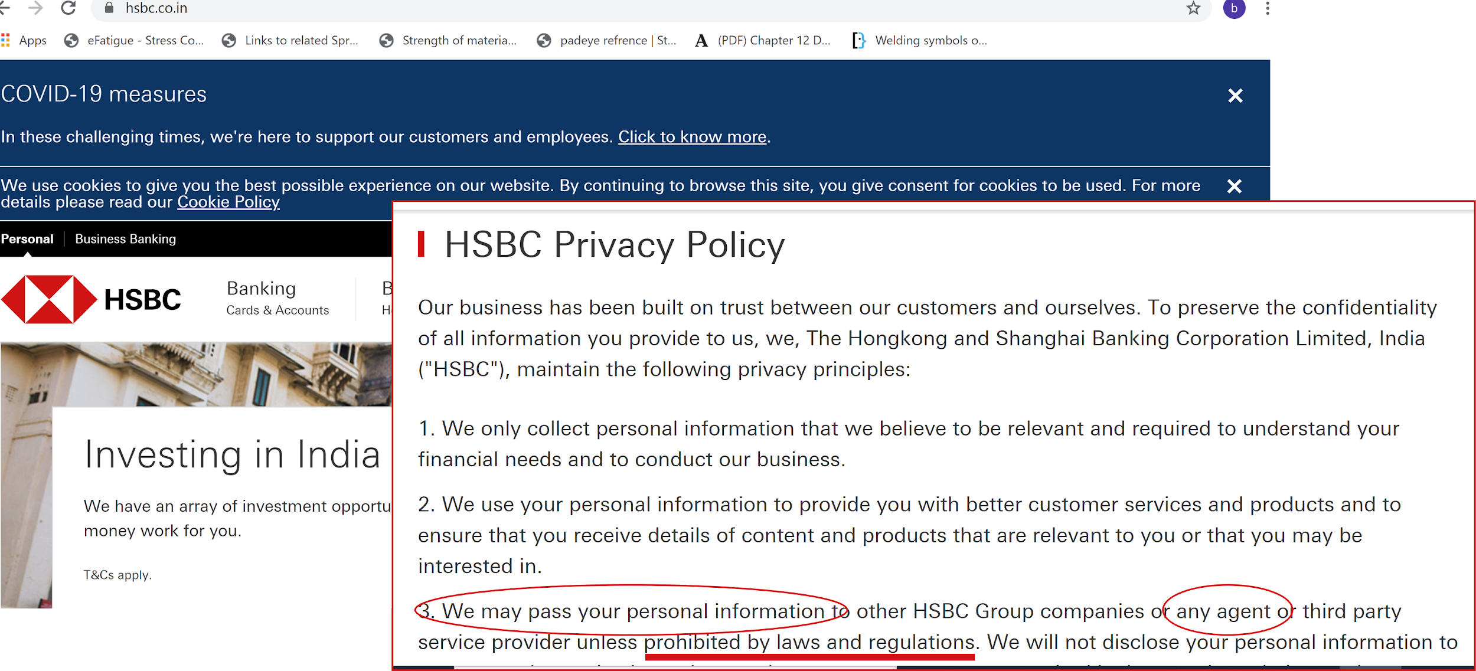
Data Protection Online
GDPR in India

Slide 7
A Change in (Data) Mindset
What to do?
Awareness
Exercise your right to choose (cookies)
Positive attitude towards data security
Report a breach - (ICO - Information Commissioners Office)

